Slide 1

INTERNSHIP REPORT For WEEK 7
MITRE ENGAGE
& HONEYPOTS
-ARUN ASHOK BADRI

Slide 2
INTERNSHIP GOALS :
(1) read the MITRE Engage documents; each one of you needs to select one of the goals (Expose, Affect, and Elicit) to study deeper and define each action under these goals in detail.
(2) Propose possible actions to be implemented in SSH honeypot and AD honeypot. There are about 10 to 20 actions listed under each goal. Try to propose corresponding actions for these two honeypots.
(3) Real implementation: Each of you needs to implement at least four actions according to your design in (2) in the real honeypots.

Slide 3
MITRE ENGAGE AND IMPLEMENTATION OF AFFECT GOAL USING HONEYPOTS
INTERNSHIP REPORT PLAN
Month 1: Orientation and Goal Selection
Month 2: Proposal and Planning for Honeypot
Month 3: Implementation and Documentation

Slide 4
Goals for this week
As mentioned in my last week report
> Start setting up the Honeypot
> Configure ELK Stack to run in sync with Tpot
> Use Kali to demonstrate some attacks
> Set up Lures
> Implement “Affect” Goal of Engage Matrix
> Do a final implementation of proposed actions for the SSH honeypot

Slide 5
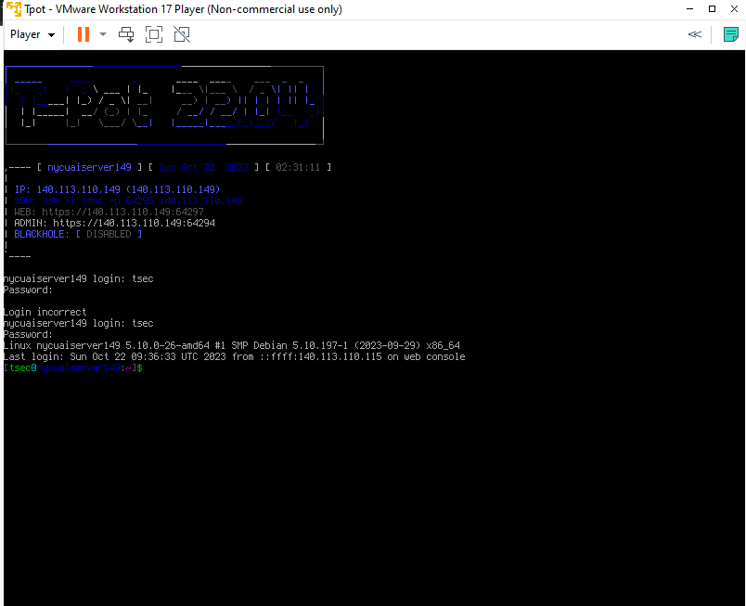
> Start setting up the Honeypot
IP address of the tpot
Connected to the Router using static IP
IP : 140.113.110.149

Slide 6
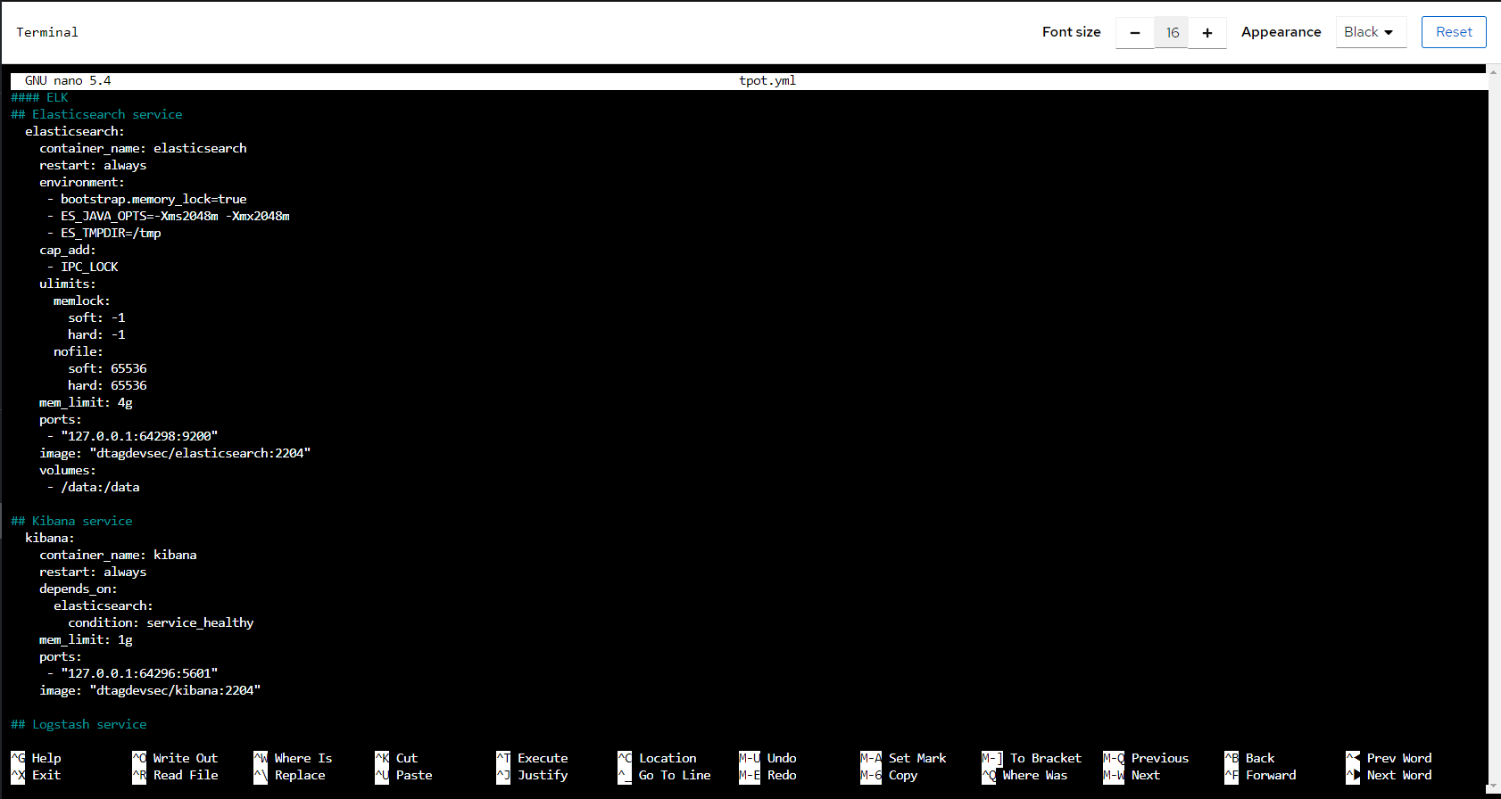
> Configure ELK Stack to Tpot
140.113.110.149:64297

Slide 7
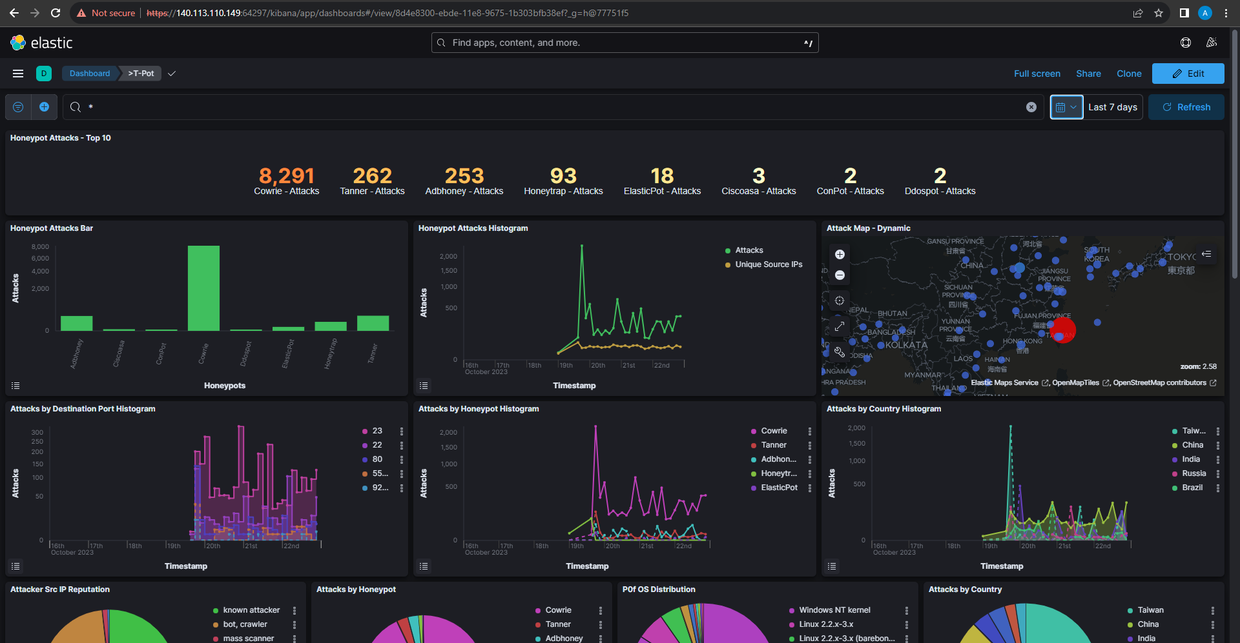
> Configure ELK Stack to Tpot
8291 Attacks on Cowrie

Slide 8
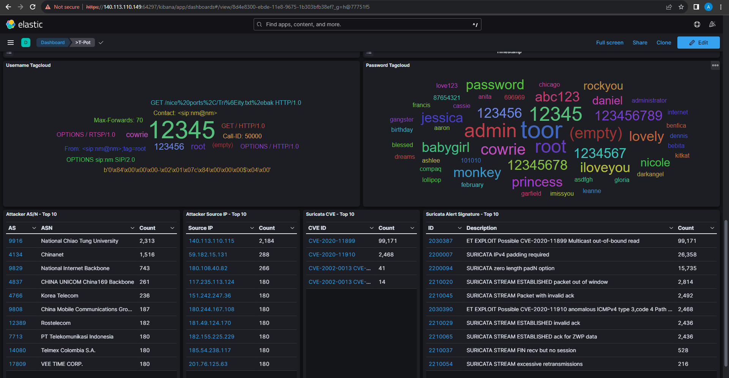

> Configure ELK Stack to Tpot
Username & Passwords
Top Attackers

Slide 9
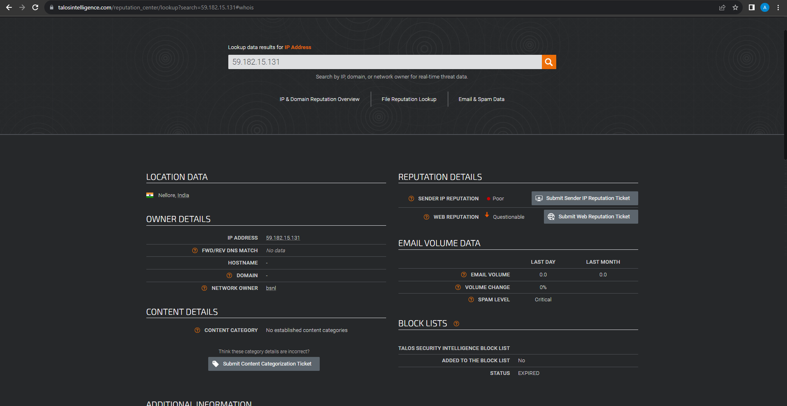
> Configure ELK Stack to Tpot
Talos intelligence report

Slide 10
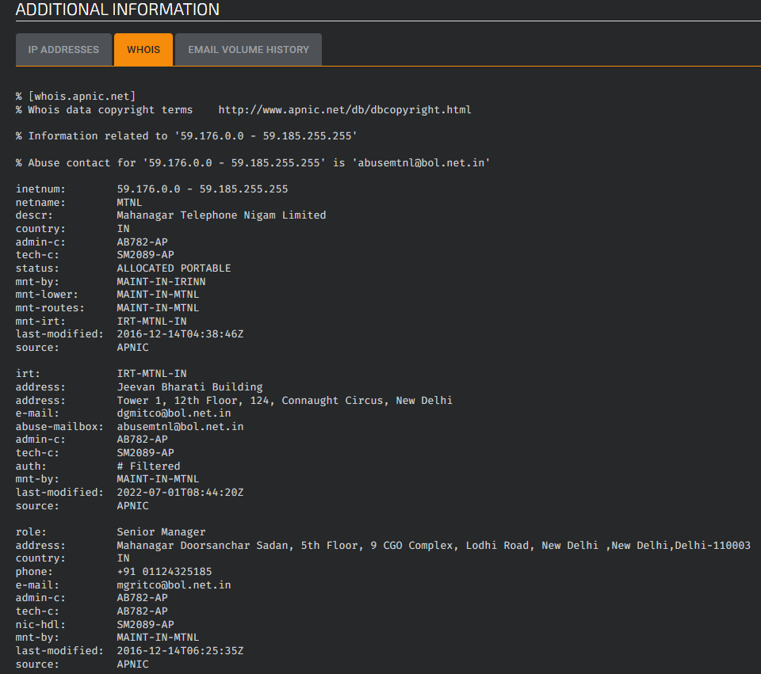
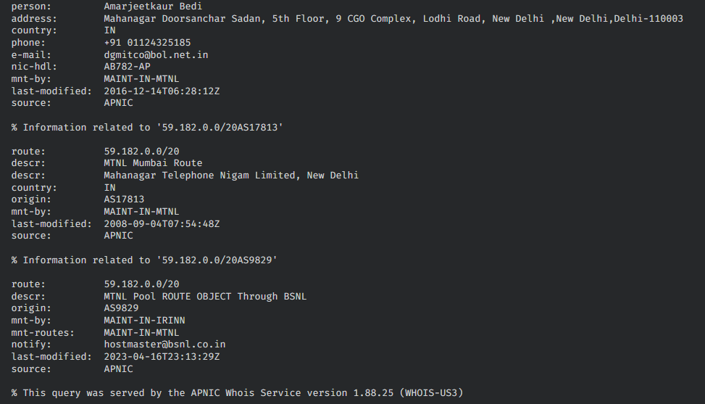
> Configure ELK Stack to Tpot
Personal details of the Ip Owner

Slide 11
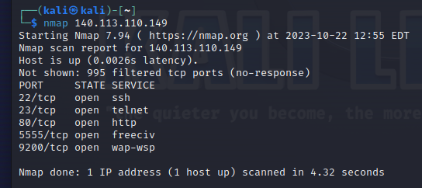
> Using kali to attack tpot

Slide 12
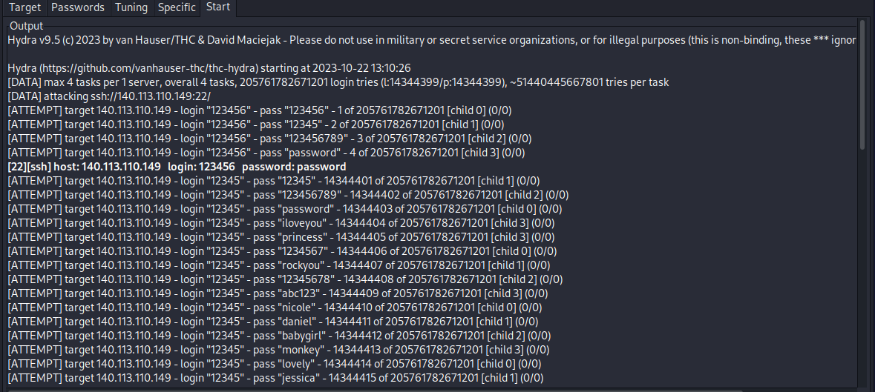
> Using kali to attack tpot
Hydra attack on port 22 for SSH Connection

Slide 13
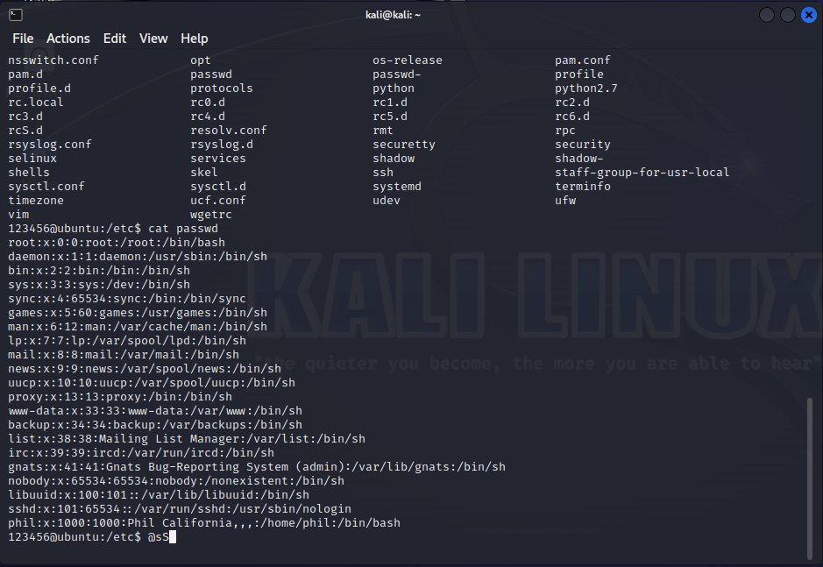
> Using kali to attack tpot
Connection via port 22 using 123456 & password
cat /etc/passwd

Slide 14
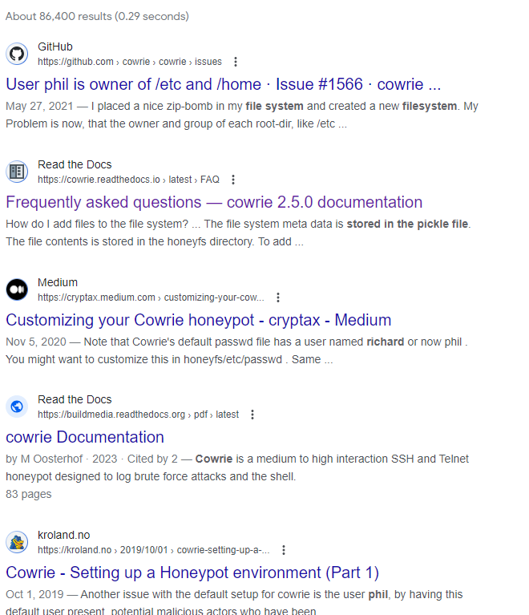
> Using kali to attack tpot
phil is widely associated with Cowrie honeypot file system
------> we need to create a different file system to make it enticing for attackers to attack
------> Setup Lures for the cowrie honeypot

Slide 15
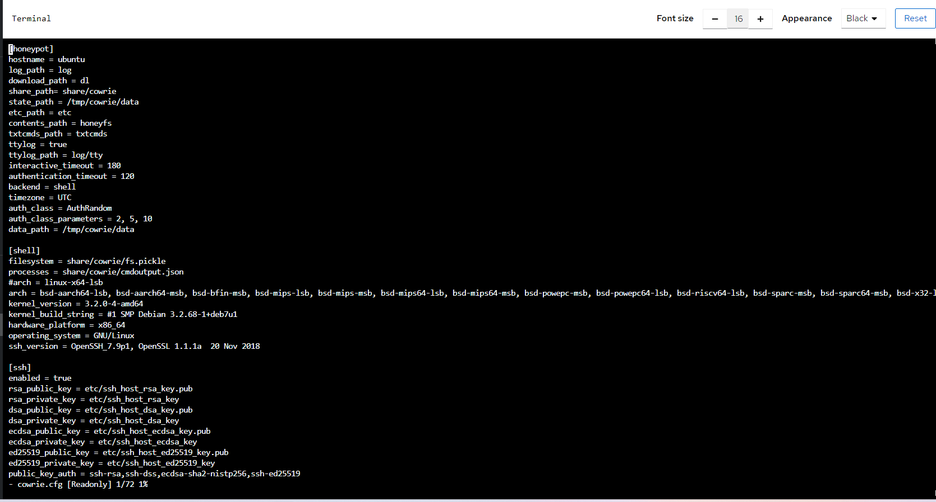
> Setting up lures in cowrie
But first, lets understand the configuration
Authorisation for SSH
FIle system of Cowrie --> eg:Phil
FS needs to be changed

Slide 16
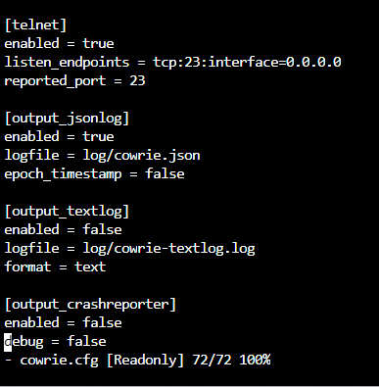
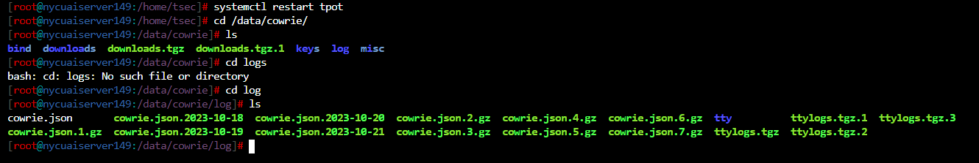
> Setting up lures in cowrie
cowrie.conf file log output
Logs of cowrie -->>
cd /data/cowrie/log/

Slide 17
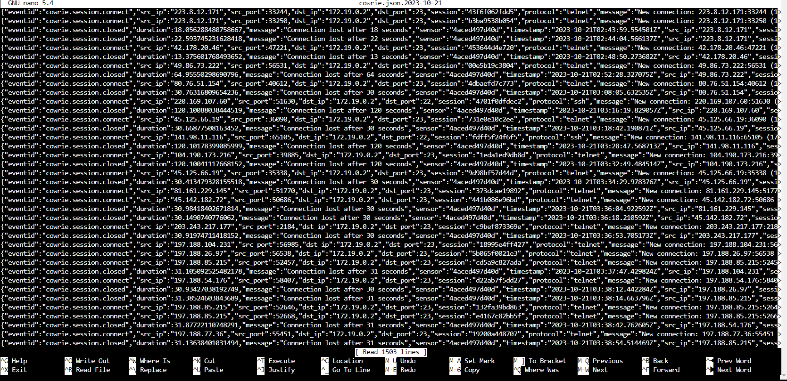
> Setting up lures in cowrie

Slide 18
> Setting up lures in cowrie
Overall, there are 4 places for configuration:
> The Cowrie config file
> Fake commands
> The honeypot filesystem
> The pickle filesystem

Slide 19
> Setting up lures in cowrie
1.The Cowrie config file -->
./etc/cowrie.cfg
This is the main config file of the honeypot. You can configure path names (and hence modify names below), login options, prompts, architecture etc.

Slide 20
> Setting up lures in cowrie
1.The Cowrie config file -->
./etc/cowrie.cfg
Instead of AuthRandom, we can use Userdb

Slide 21
> Setting up lures in cowrie
2.Fake commands -->
./share/cowrie/txtcmds
> It would take too much time to emulate all commands.
> Some of them can be very basically emulated by always returning the same text, such as command usage or error.
> This is the directory for such commands.

Slide 22
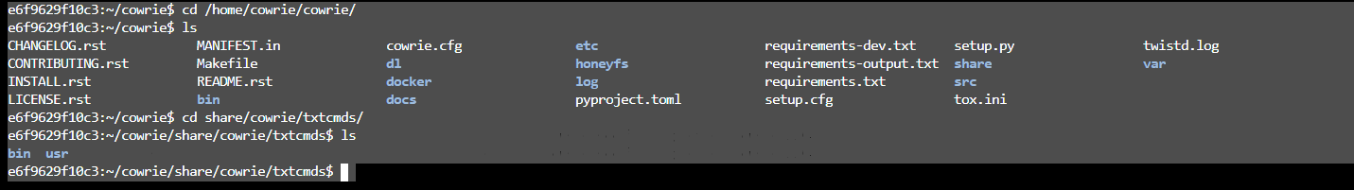
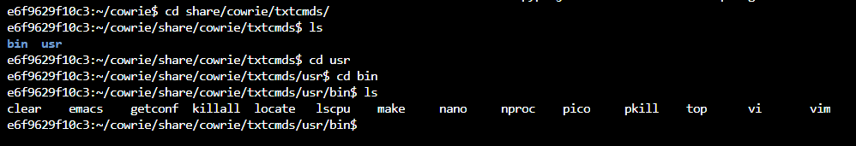
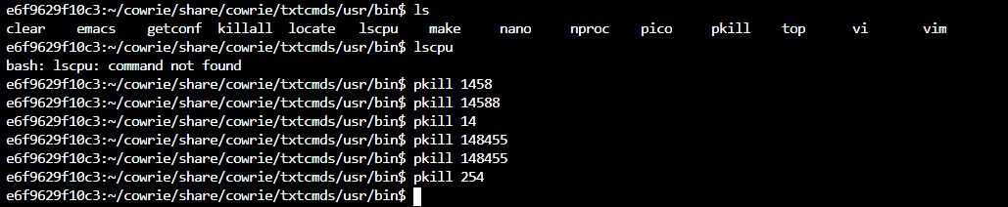
> Setting up lures in cowrie
2.Fake commands -->
./share/cowrie/txtcmds
Preconfigured commands
No effect on the processes

Slide 23
> Setting up lures in cowrie
3.The honeypot filesystem -->
./honeyfs
> This is where you place a tree of files you want the attacker to see.

Slide 24
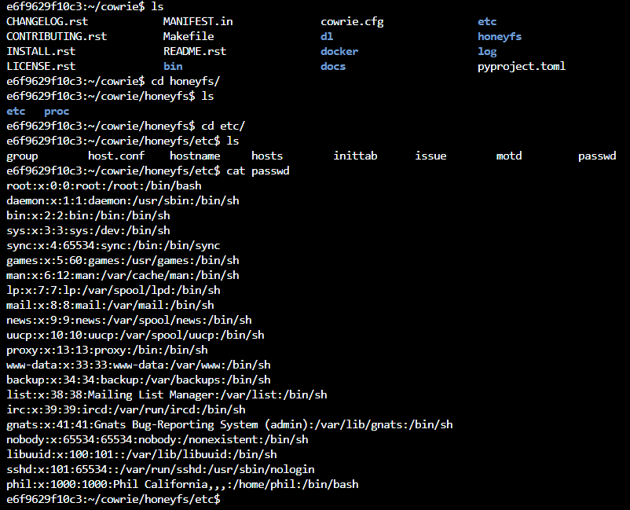
> Setting up lures in cowrie
3.The honeypot filesystem -->
./honeyfs
honeyfs is the ‘’actual’’ filesystem of the honeypot
Need to edit the etc/passwd file
Add new users and passwords

Slide 25
> Setting up lures in cowrie
4.The pickle filesystem -->
./share/cowrie/fs.pickle
> This is a virtual filesystem: files in there won’t really exist (you can’t cat them for example) but they get listed in the tree of files.
> This helps make it look real, while not copying each file (would take space).

Slide 26
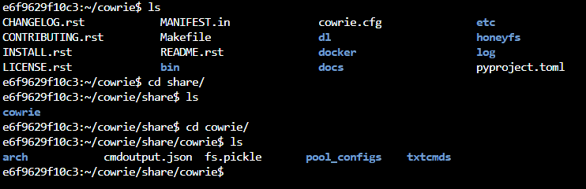
> Setting up lures in cowrie
4.The pickle filesystem -->
./share/cowrie/fs.pickle
fs.pickle is the ‘fake’ filesystem of the honeypot
can Include fake sensitive docs

Slide 27
> Setting up lures in cowrie
3.The honeypot filesystem
We need to combine both honeyfs and fs.pickle to establish actual files in the environment
> If file is in honeyfs without being in fs.pickle it wont be visible to attacker
> If file is present in fs.pickle without being in honeyfs, the file wont be executable nor read
4.The pickle filesystem

Slide 28
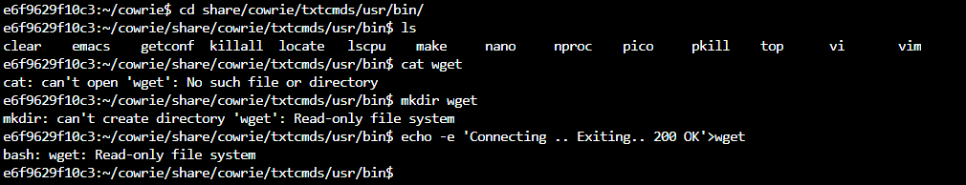
> Start implementation
Error due to the Docker container being in a read only state

Slide 29
Goals for next week
> Create a new fs.pickle for the cowrie
> Create a new honeyfs file system in cowrie
> Integrate both and deploy Cowrie
> Real implementation of ‘Lures’ of Affect goal
> Search for other possible implementations for any Affect goal approaches

Slide 30
Thank
you!

